Slide 1
RISE logic model development

Slide 2
Day 1 objectives
Purpose
Document collection
Terminology
Warm up
Let’s get started!

Slide 3
Purpose
Intended results
Feedback & reflections
Planned work
Notes:
A logic model is a graphic depiction (road map) that presents the shared relationships among the resources, activities, outputs, outcomes, and impact for your program. It depicts the relationship between your program’s activities and its intended effects.

Slide 4
Helpful documents
Mission and vision
Goals and objectives
Current program descriptions such as websites, program descriptions, fact sheets
Strategic plans
Business, communication, and marketing plans
Existing/previous logic models
Existing performance measures and/or program reviews

Slide 5
Terminology
Resources/Inputs
Activities
Outcomes
Impact
Outputs

Slide 6
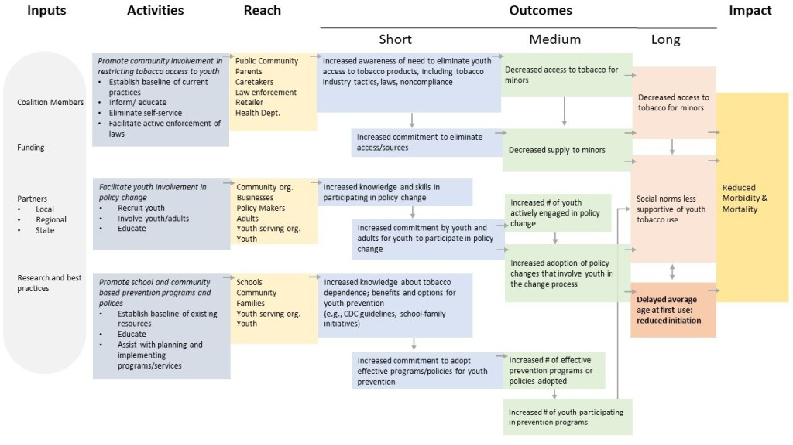
Examples
Notes:
http://danawanzer.com/logicmodel-eval17/

Slide 7
Warm up!
What do you see as the main outcomes of the program?
What do you see as the main activities of the program?
Which of the activities and outcomes are most important to you? Which activities must be effectively implemented and/or which outcomes achieved?

Slide 8
Let’s get started!

Slide 9
Day 2 objectives
Continuing filling in logic model components
Order activities, as needed
Draw connections

